Slide 1

MAJOR PROJECT (MCAN-482) PPT PRESENTATION ON CROP RECOMMENDATION SYSTEM SESSION: 2022-2024
PROJECT GUIDE:
Mr. Soumen Prakash Kabi
Team Members:
Siddhartha Khawas (10871022006)
Subham Chakraborty (10871022007)
Sumit Kumar Choubey (10871022003)
Shivendu Shivam (10871022051)

Slide 2
Acknowledgement
Declaration
Project Objective & Scope
Data Description
Methodology
Data Preprocessing
Models Used
Accuracy Comparison
GUI snapshot
Future Scope of Improvements
Contents

Slide 3
ACKNOWLEDGEMENT
We express our deep gratitude to Mr. Soumen Prakash Kabi from the Department of Computer Application at Asansol Engineering College for his invaluable guidance and steadfast support throughout our project on the "Crop Recommendation System." His expert advice and constant encouragement were instrumental in helping us navigate the challenges of this project. We are immensely thankful for his mentorship and the knowledge he shared with us.
We would also like to pay our heartiest thanks and gratitude to Dr. Sujit Kumar Singh, HOD and all the faculty members of department of Computer Application, Asansol Engineering College for various suggestions being provided in attaining success in our work.
We would like to express our earnest thanks to all technical staff of the Computer Application, and Higher authorities of Asansol Engineering College for their valuable assistance being provided during our project work.
Finally, we would like to express our deep sense of gratitude to our parents for their constant motivation and support throughout our work.
Thank You all for your support.
SIDDHARTHA KHAWAS (10871022006)
SUBHAM CHAKRABORTY (10871022007)
SHIVENDU SHIVAM (10871022051)
SUMIT KUMAR CHOUBEY (10871022003)

Slide 4
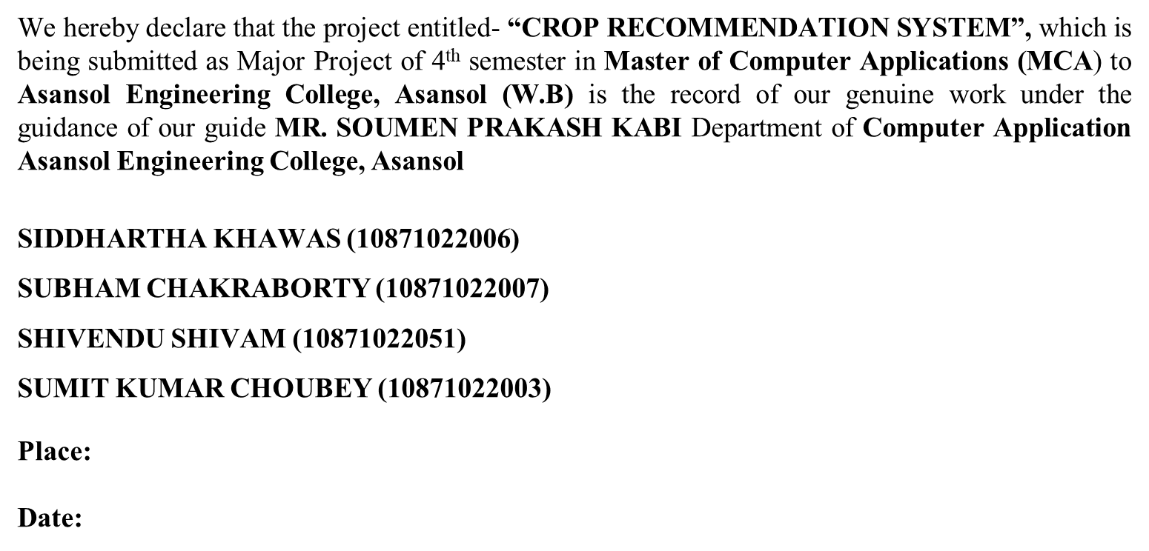
DECLARATION

Slide 5
Project objective & scope
Objective:
To develop an intelligent crop recommendation system that uses machine learning to analyse soil nutrients (Nitrogen, Phosphorus, Potassium), environmental data (Temperature, Humidity, Rainfall), and soil pH to advise farmers on the most suitable crops to cultivate for optimal yield.
Goal:
Create a robust predictive model that inputs Nitrogen, Phosphorus, Potassium, Temperature, Humidity, pH, and Rainfall to generate accurate and personalized crop recommendations, thus increasing agricultural efficiency and sustainability.
Scope:
It is a useful project as the classifier models can be used to quickly determine the suitable crop for the cultiave in the soli of the large dataset.

Slide 6
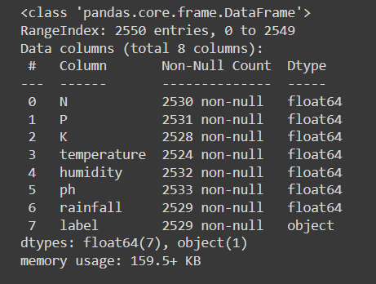
Data description
The description of the data with type and description of each Attribute is given/shown in the table.

Slide 7
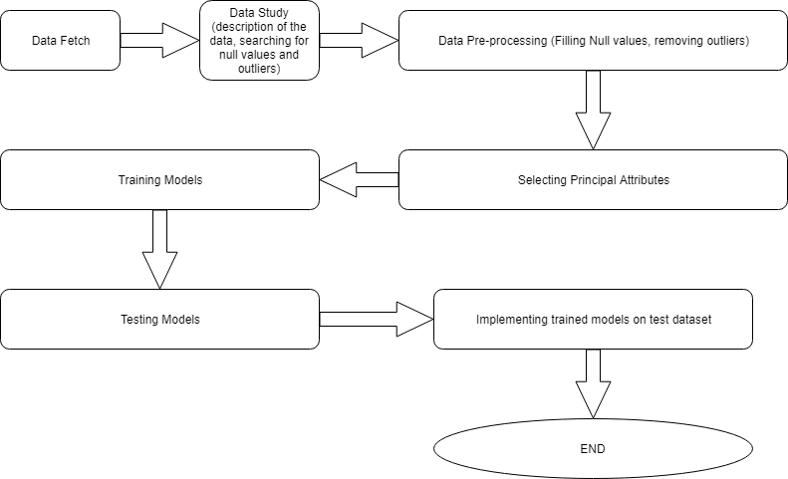
Methodology

Slide 8
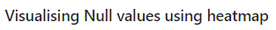
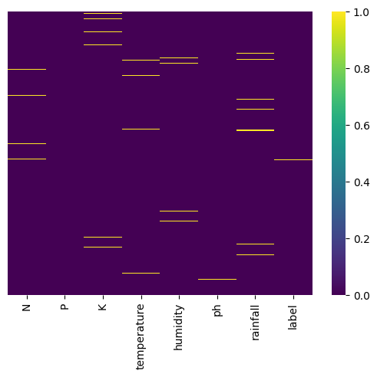
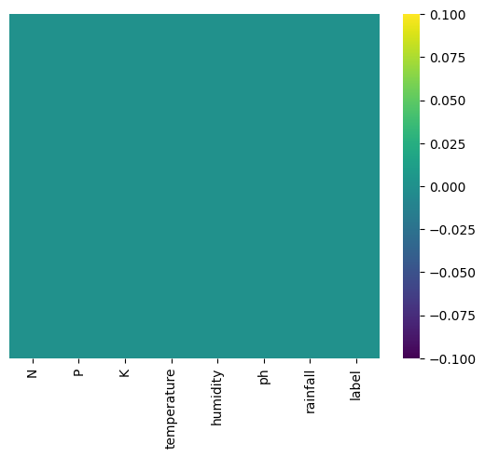
Data Preprocessing
Handling Null values
Before
After

Slide 9
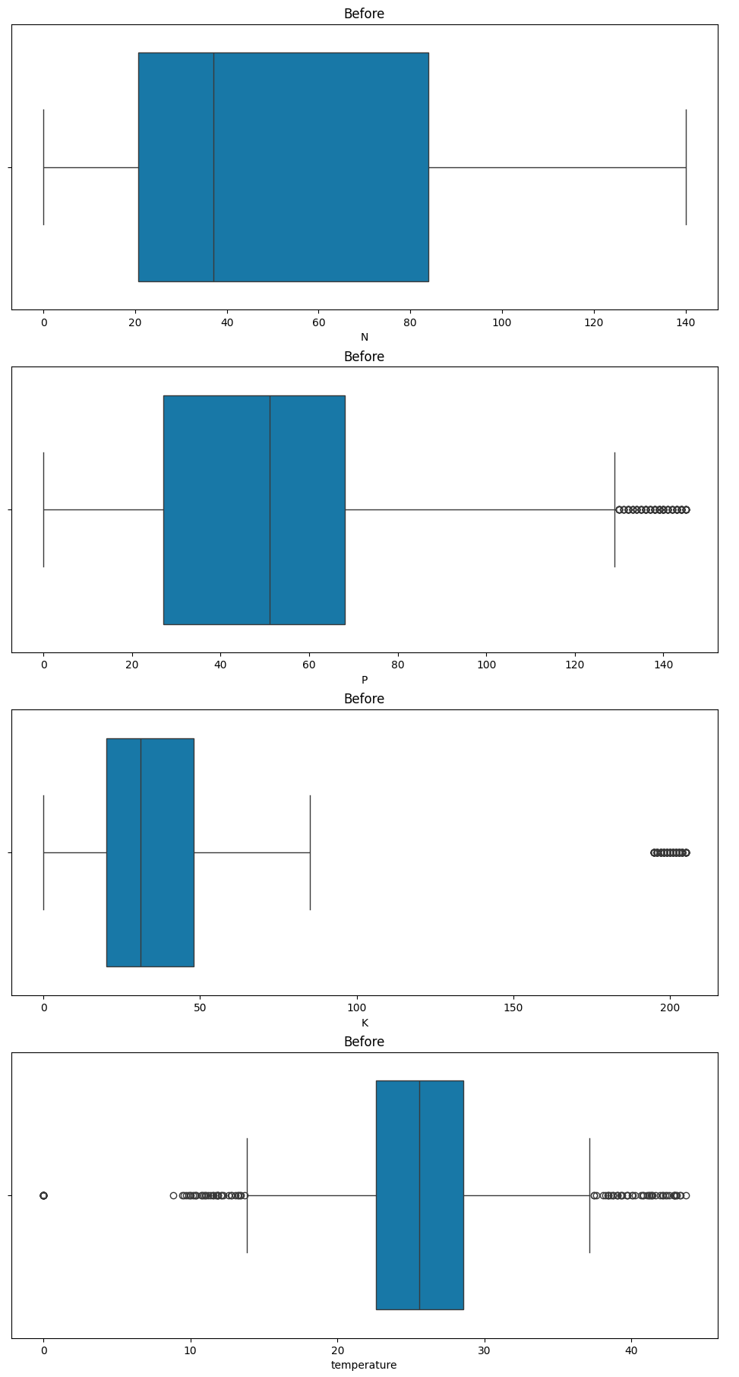
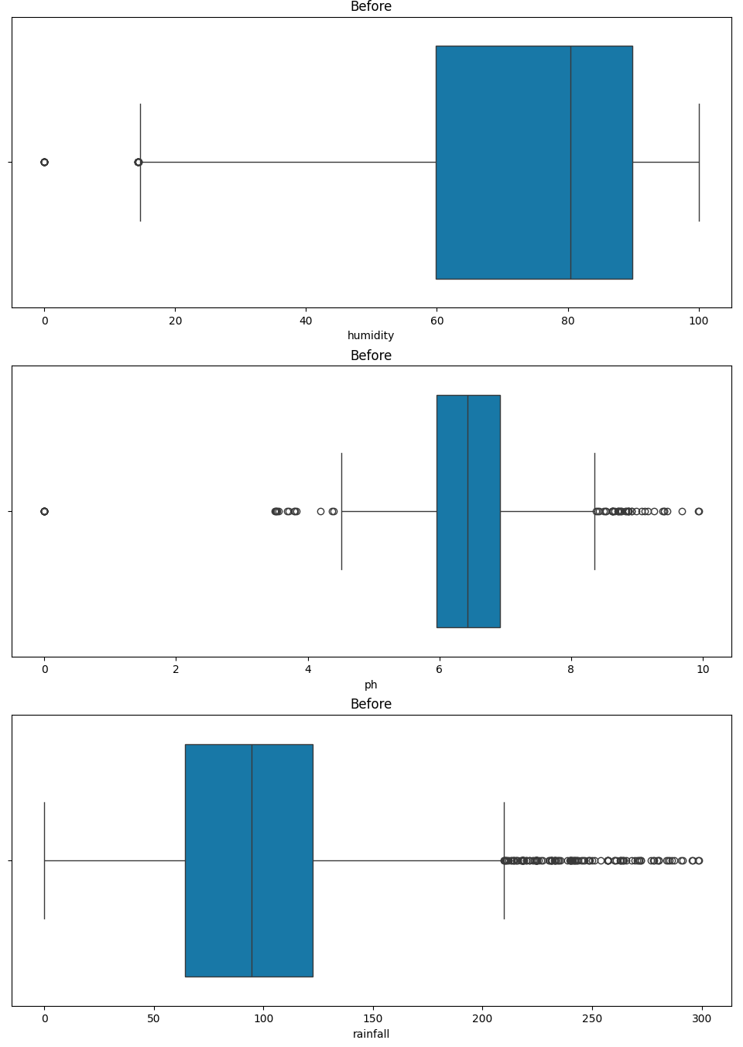
Outliers

Slide 10
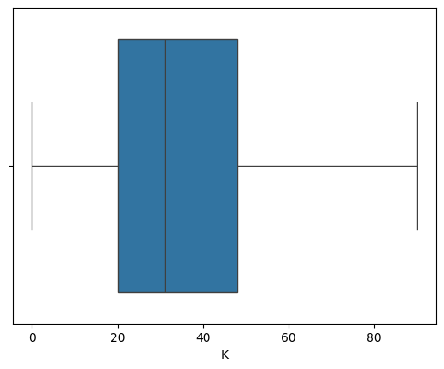
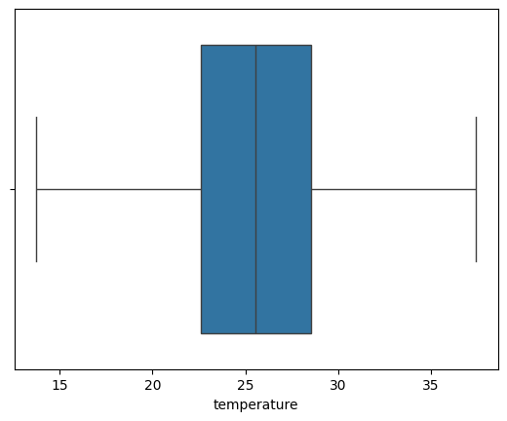
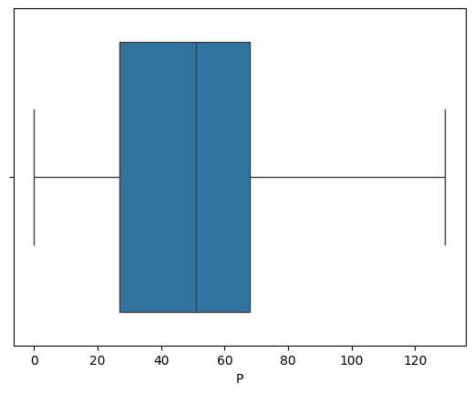
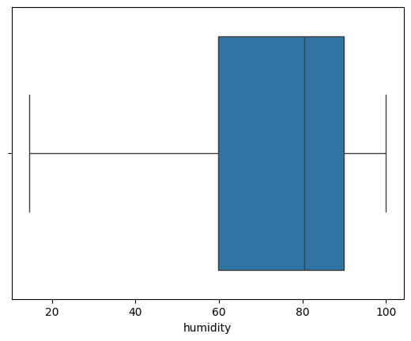
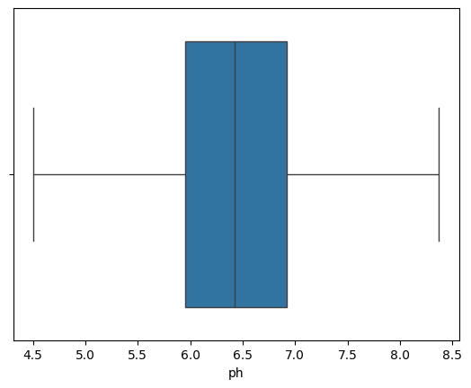
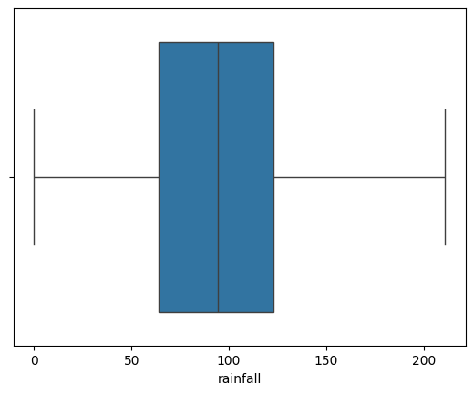
After removing the outliers

Slide 11
Models used
The Machine Learning models used for this project are:
Decision Tree
Logistic Regression
Random Forest
SVM Classifier

Slide 12
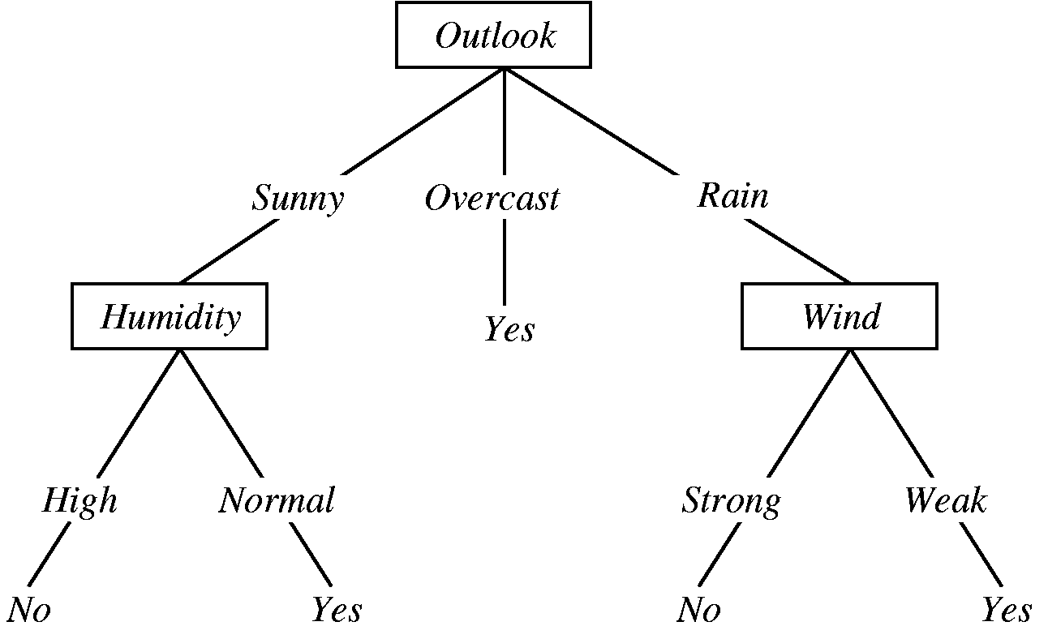
Decision tree
Decision Tree is a Supervised learning technique that can be used for both classification and Regression problems, but mostly it is preferred for solving Classification problems. It is a tree-structured classifier, where internal nodes represent the features of a dataset, branches represent the decision rules and each leaf node represents the outcome.
It is a graphical representation for getting all the possible solutions to a problem/decision based on given conditions.

Slide 13
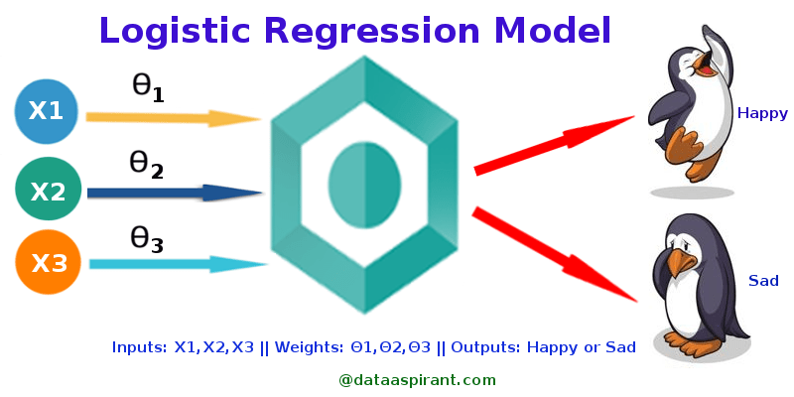
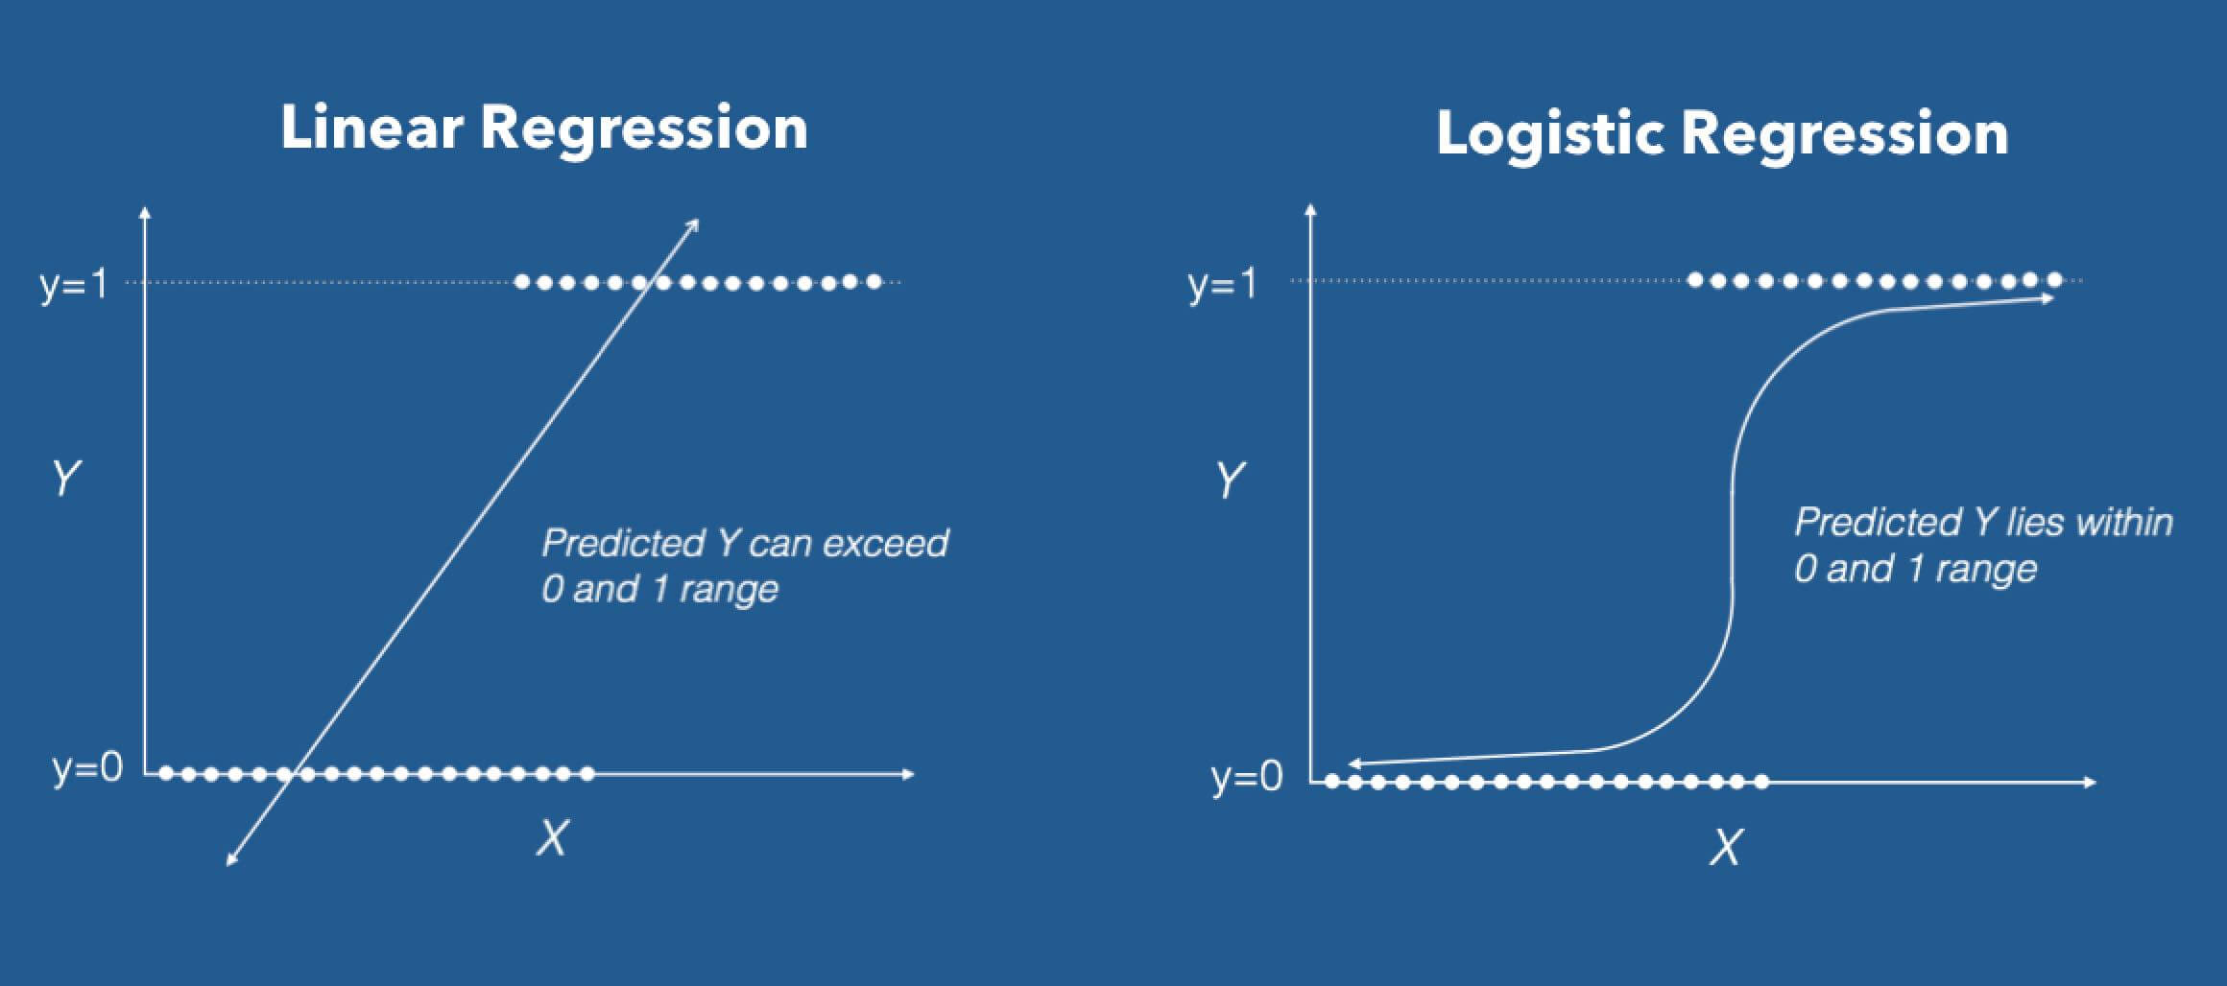
Logistic regression
Logistic regression is one of the most popular Machine Learning algorithms, which comes under the Supervised Learning technique. It is used for predicting the categorical dependent variable using a given set of independent variables.
Logistic regression predicts the output of a categorical dependent variable. Therefore the outcome must be a categorical or discrete value. It can be either Yes or No, 0 or 1, true or False, etc. but instead of giving the exact value as 0 and 1, it gives the probabilistic values which lie between 0 and 1.

Slide 14
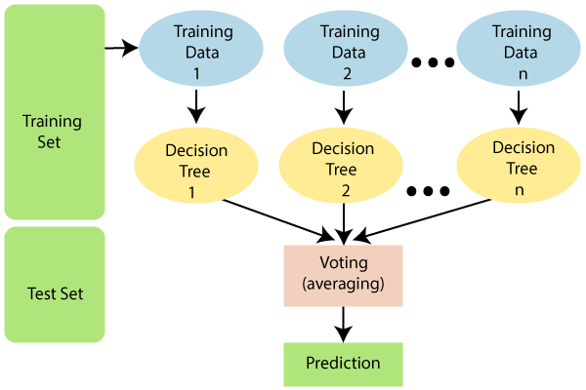
Random Forest
Random Forest is a classifier that contains a number of decision trees on various subsets of the given dataset and takes the average to improve the predictive accuracy of that dataset. Instead of relying on one decision tree, the random forest takes the prediction from each tree and based on the majority votes of predictions, and it predicts the final output.
The greater number of trees in the forest leads to higher accuracy and prevents the problem of overfitting.

Slide 15

Support Vector Machine Algorithm (SVM)
Support Vector Machine or SVM is one of the most popular Supervised Learning algorithms, which is used for Classification as well as Regression problems. However, primarily, it is used for Classification problems in Machine Learning.
The goal of the SVM algorithm is to create the best line or decision boundary that can segregate n-dimensional space into classes so that we can easily put the new data point in the correct category in the future. This best decision boundary is called a hyperplane.

Slide 16
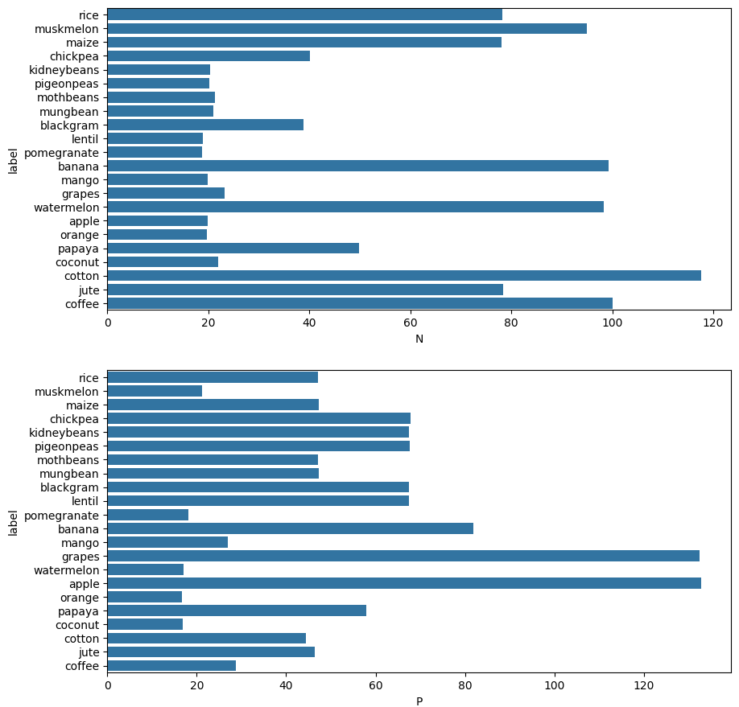
Visualising other attributes with respect to our target column i.e. 'Label'

Slide 17
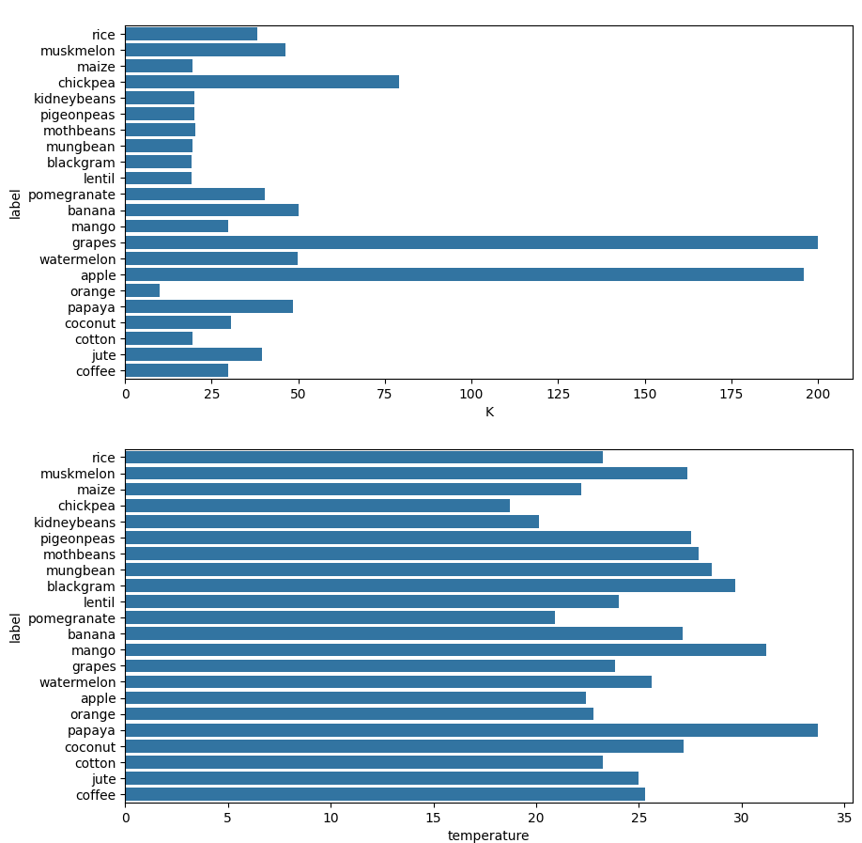

Slide 18
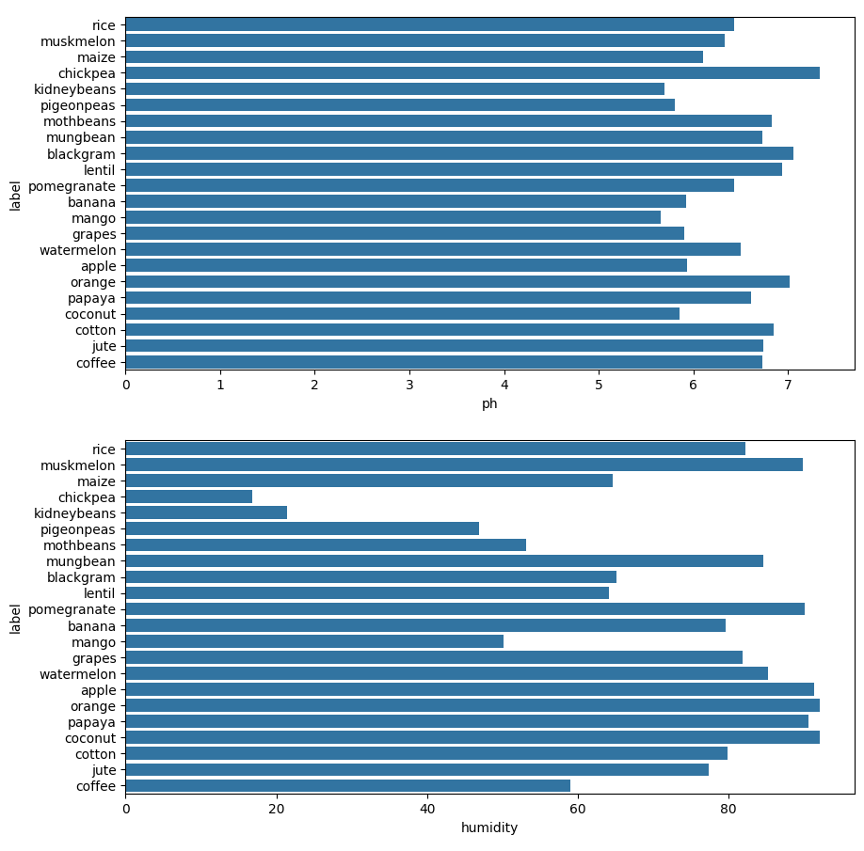

Slide 19
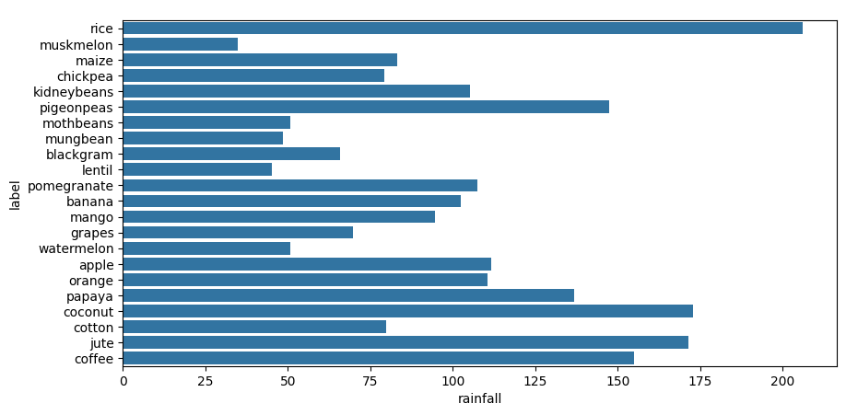

Slide 20
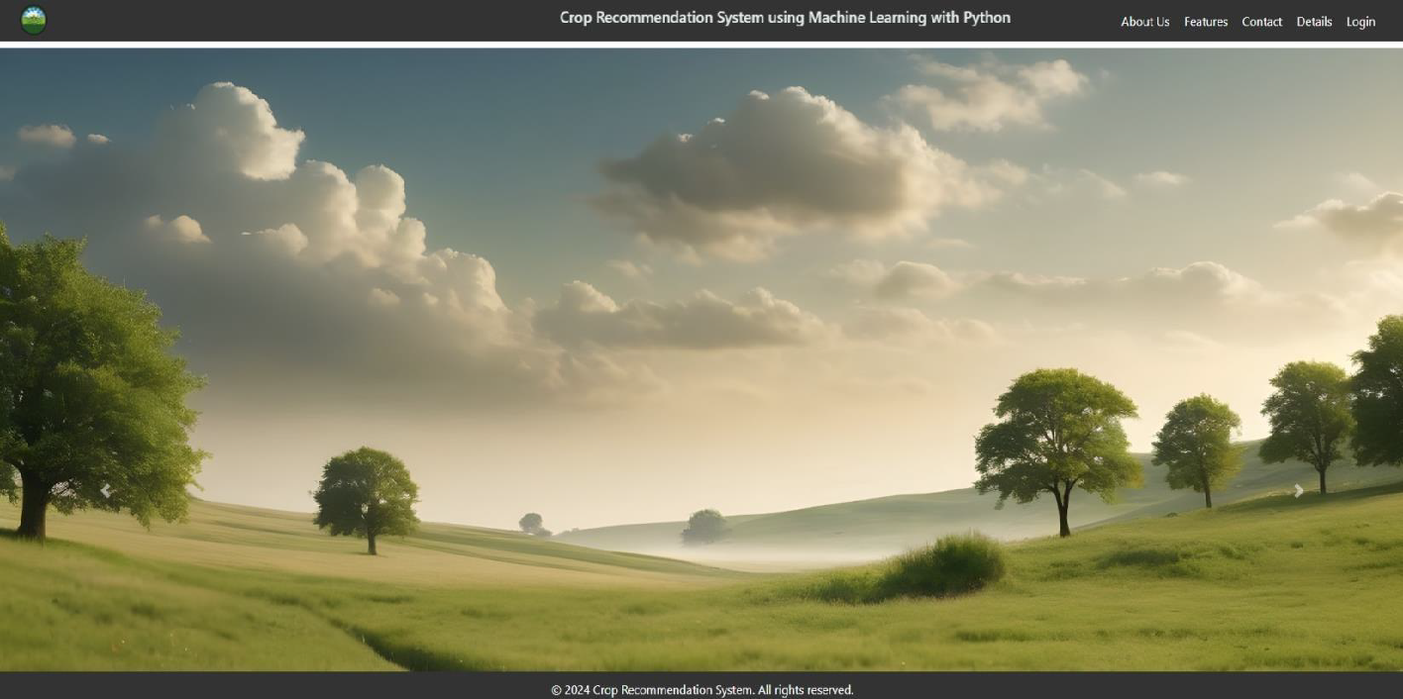
GUI Version of Crop Recommendation System
(index page)

Slide 21
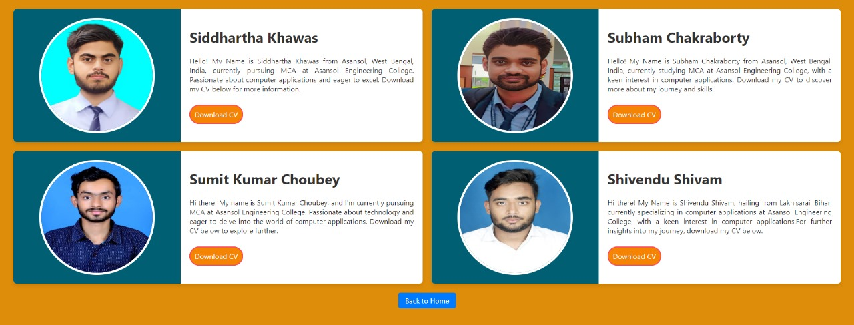
GUI Version of Crop Recommendation System (About us page)

Slide 22
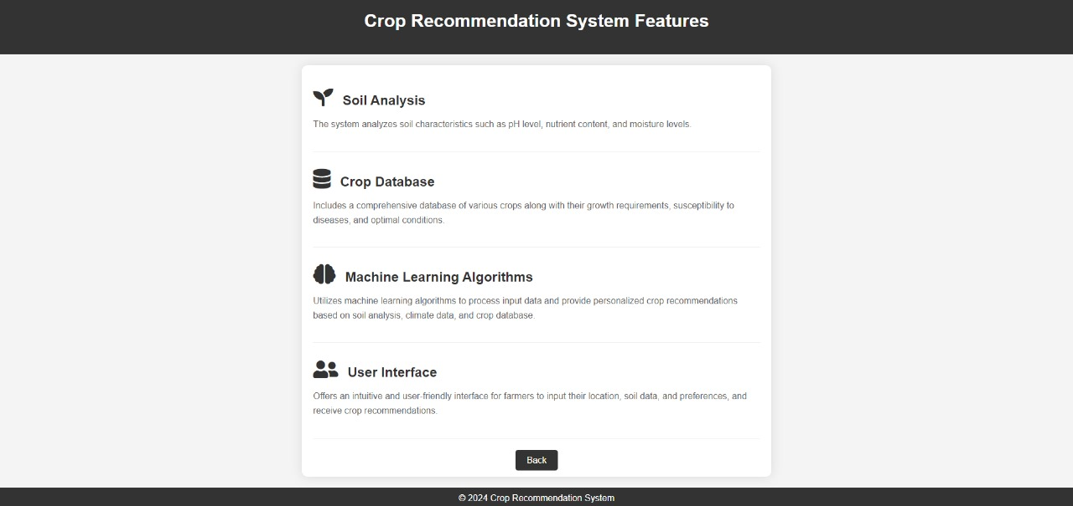
GUI Version of Crop Recommendation System (Features page)

Slide 23
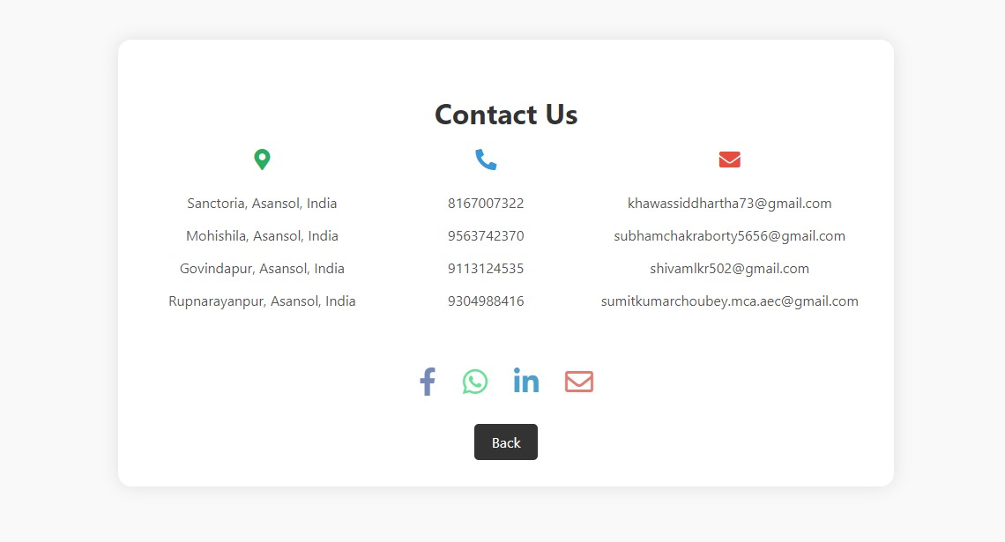
GUI Version of Crop Recommendation System (Contact page)

Slide 24
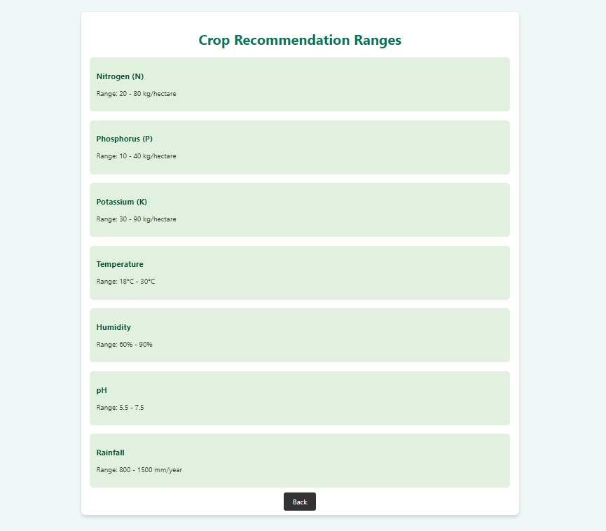
GUI Version of Crop Recommendation System (Details page)

Slide 25
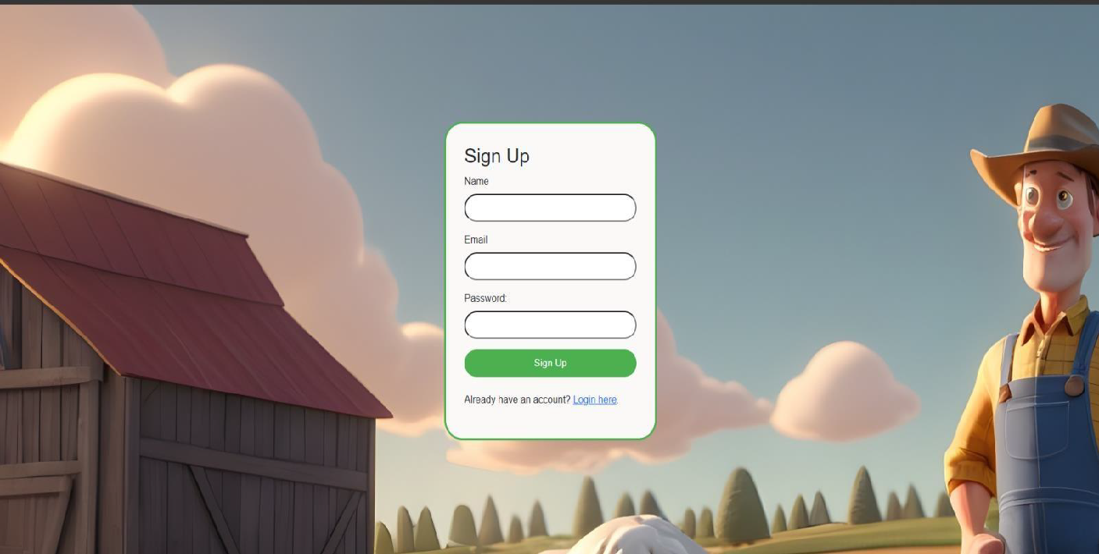
GUI Version of Crop Recommendation System (Signup page)

Slide 26
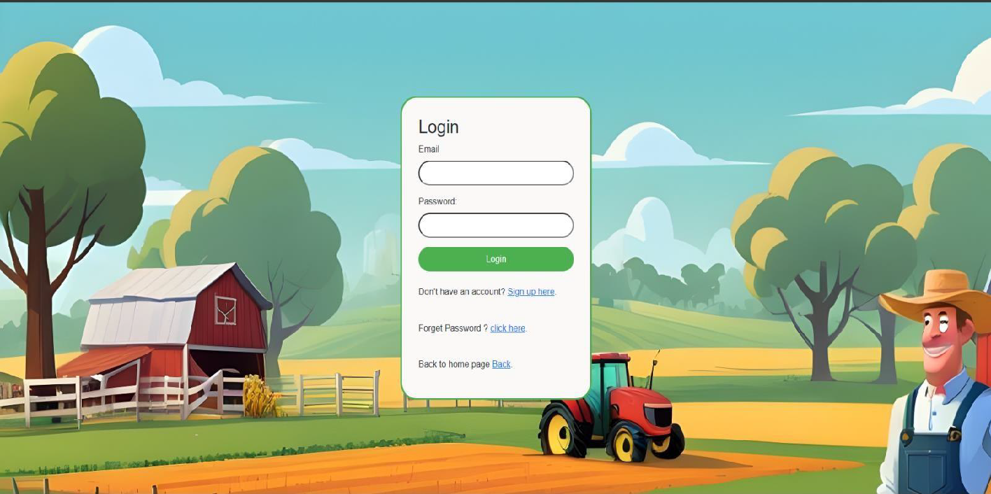
GUI Version of Crop Recommendation System (Login page)

Slide 27
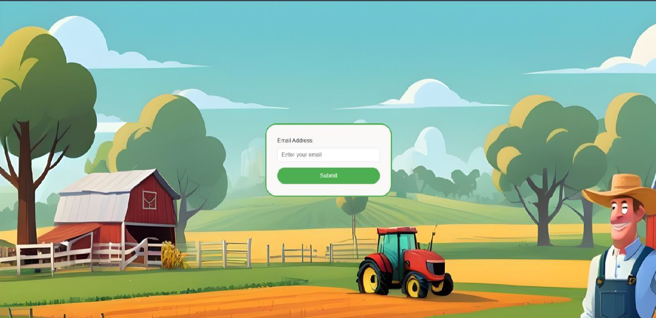
GUI Version of Crop Recommendation System (forgot your password page)

Slide 28
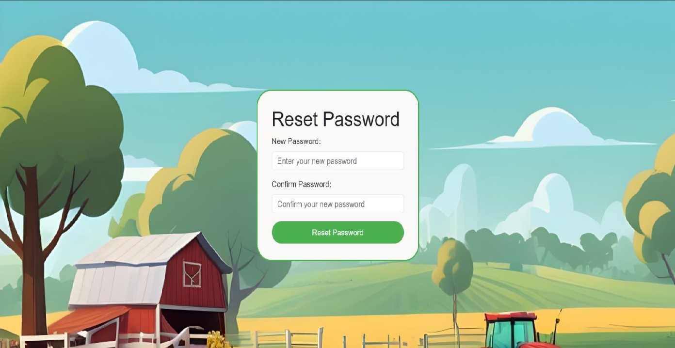
GUI Version of Crop Recommendation System (Reset page of your password )

Slide 29
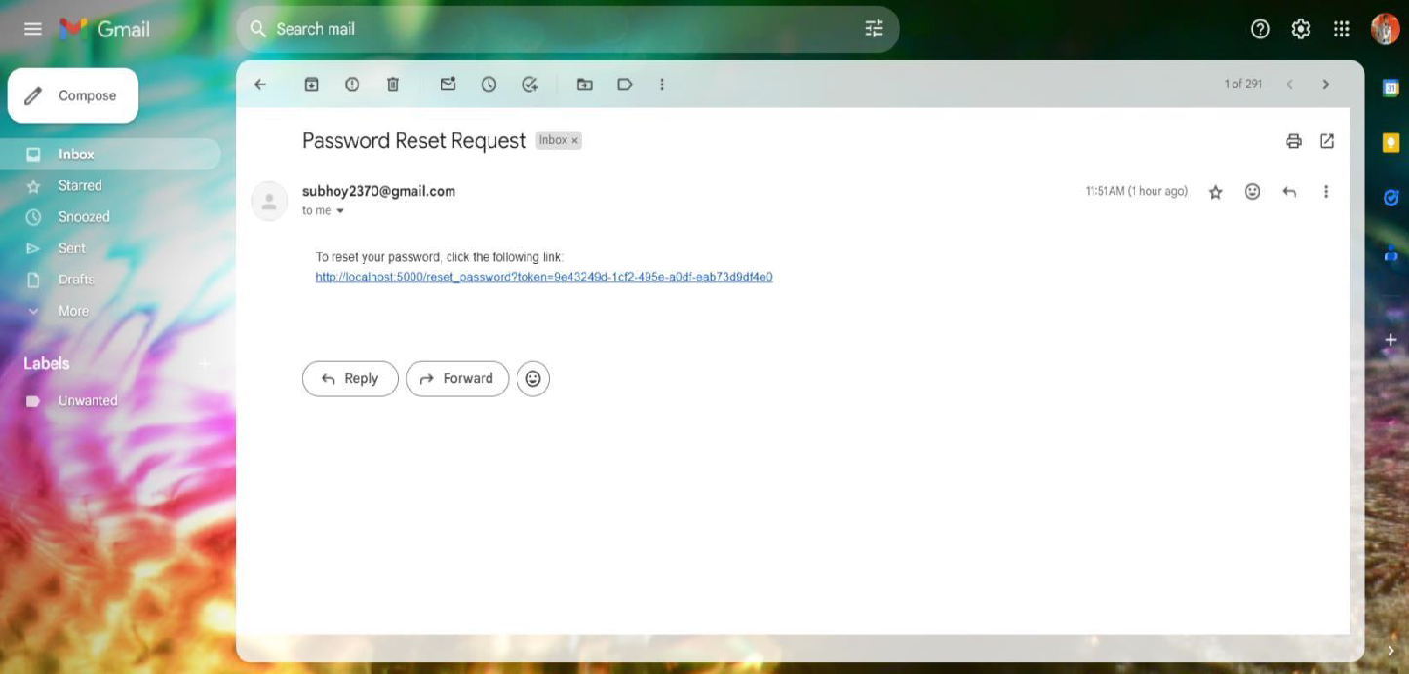
GUI Version of Crop Recommendation System (forgot password reset request mail send in your registered email id )

Slide 30
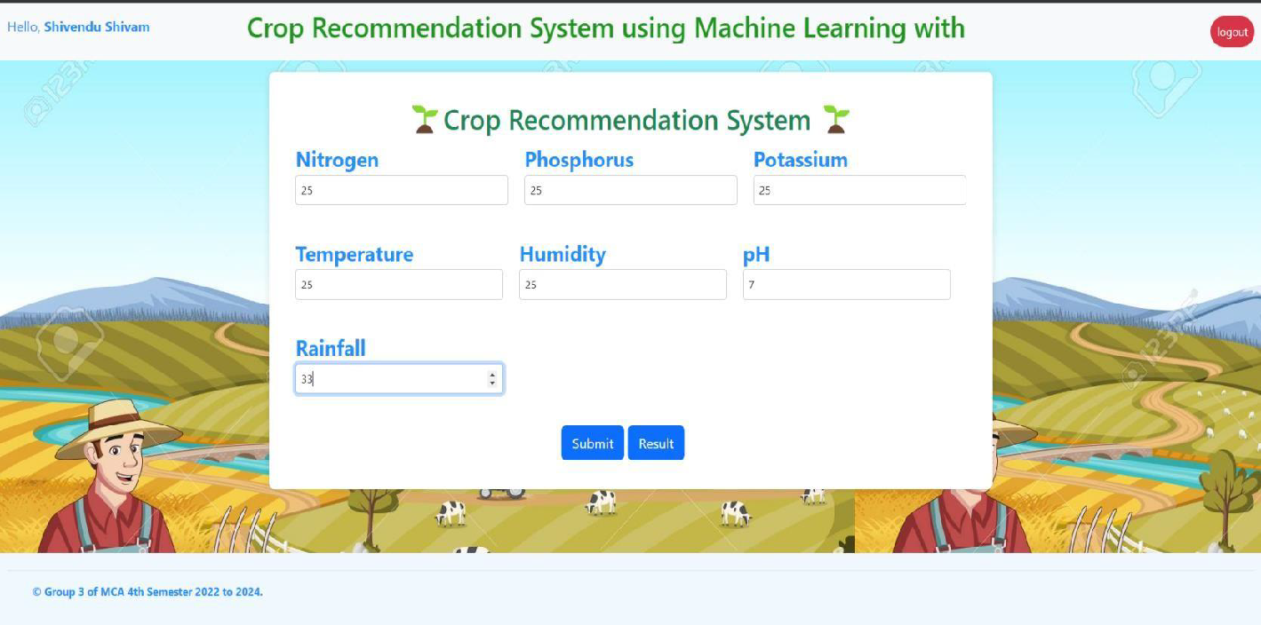
GUI Version of Crop Recommendation System (Main page)

Slide 31
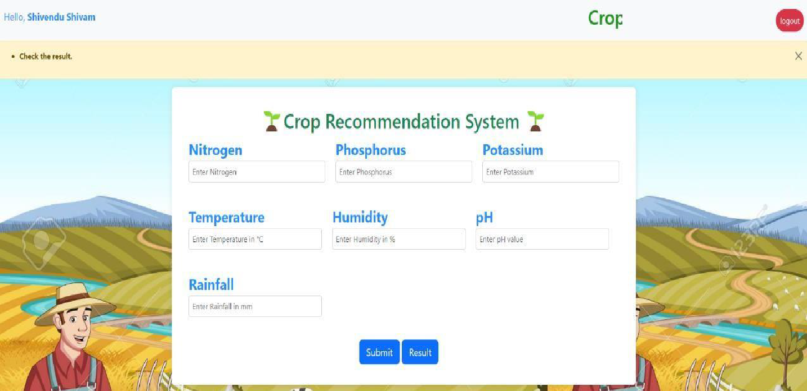
GUI Version of Crop Recommendation System (Main page)

Slide 32
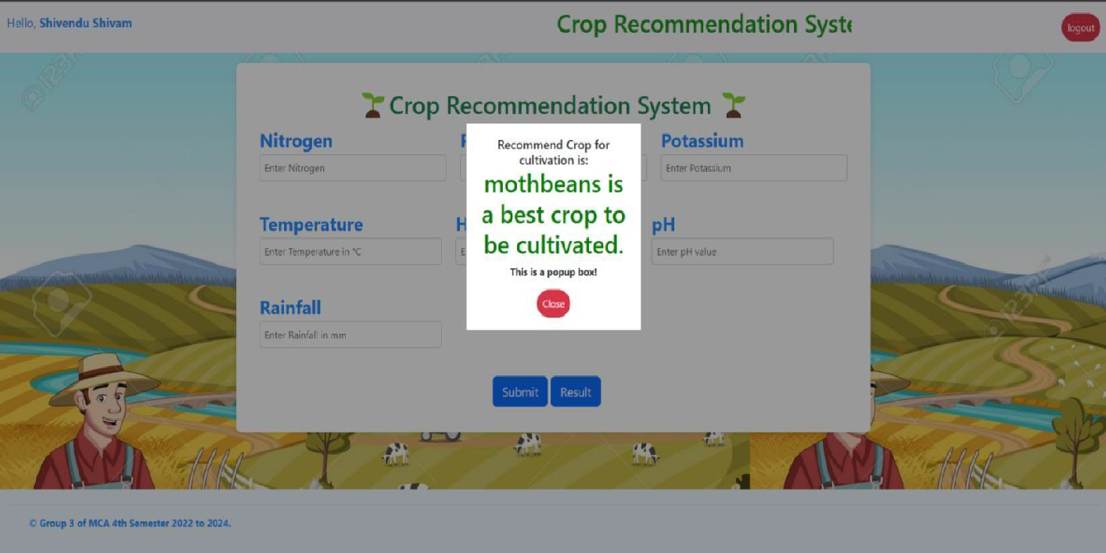
GUI Version of Crop Recommendation System (Main page with result popup)

Slide 33
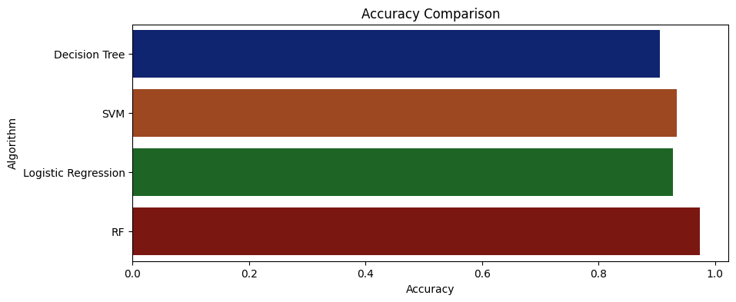
Accuracy comparison graph
Models | Accuracy %
Decision Tree | 90%
Logistic Regression | 92%
Random Forest | 97%
SVM Classifier | 93%
The data shown above is an average of multiple test runs.
We see that the highest accuracy for the train dataset is Random Forest.
So we select Random Forest model to predict the test dataset.

Slide 34
Future advancements in crop recommendation systems could involve integrating real-time data from IoT devices and satellite imagery, enhancing predictive algorithms with deep learning techniques, and personalizing recommendations based on individual farmer preferences.
Improvements in user interface design and accessibility, along with the integration of multi-criteria decision-making methods, could further enhance the usability and effectiveness of these systems.
Collaborative platforms for knowledge sharing among farmers and experts, along with extensive field testing and validation, are essential for ensuring the scalability, reliability, and impact of crop recommendation systems in diverse agricultural settings.
By addressing these areas of improvement, crop recommendation systems can better support farmers in making informed decisions, optimizing resource use, and increasing agricultural productivity
Future scope of
improvements

Slide 35
Thank you
Asansol Engineering College
Siddhartha Khawas (khawassiddhartha73@gmail.com)
Subham Chakraborty (csubham981@gmail.com)
Sumit Kumar Choubey (montuking88@gmail.com)
Shivendu Shivam (shivamlkr502@gmail.com)

